Slide 1
Introduction to Python
Sayar Zay Min Paing

Slide 2
What is Python?
Python is widely used in robotics! It's a popular choice for both beginners and professionals due to its simplicity, readability, and the powerful libraries available. Some key reasons why Python is commonly used in robotics are:
Libraries and Frameworks:
ROS (Robot Operating System): ROS is a flexible framework for writing robot software, and it has excellent Python bindings. It provides tools and libraries to help with building robot applications.
OpenCV: Used for computer vision tasks, helping robots understand their environment.
PySerial: A library to communicate with hardware over serial ports.
PyGame: Can be used for simple simulation and visualization in robotics.
Rapid Prototyping: Python’s simple syntax allows you to quickly prototype and test algorithms for robotics, making it easier to iterate and improve the design.
Simulation and Control: Libraries like PyBullet and VREP help in simulating robotic environments and controlling robotic mechanisms.
Machine Learning and AI: Python has a rich ecosystem of machine learning libraries like TensorFlow, PyTorch, and scikit-learn, which can be used to enable robots to perform tasks like object detection, path planning, and decision-making.
Interfacing with Hardware: Python can be used to control motors, sensors, and other components in a robotic system, making it versatile for various types of robots (e.g., mobile robots, drones, robotic arms).

Slide 3
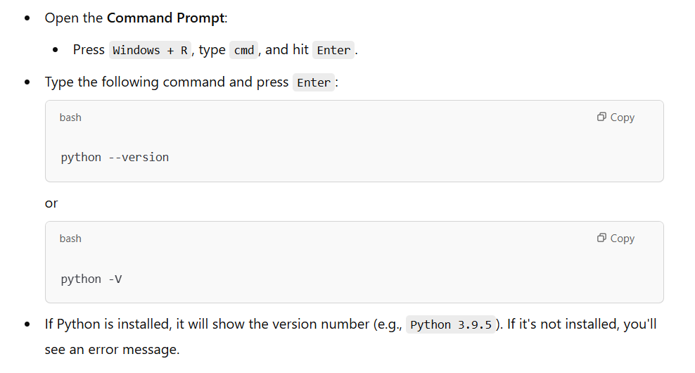
Do we have Python?

Slide 4
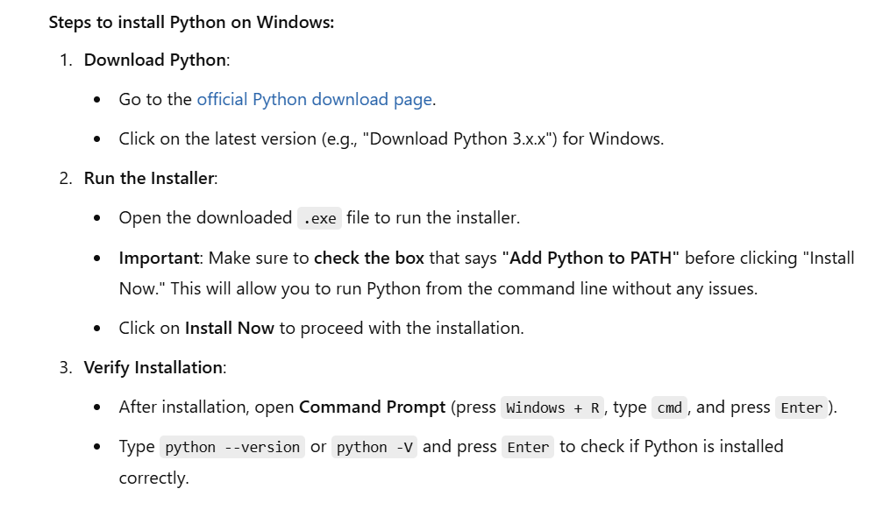
How to install Python?

Slide 5
Understanding the Core Concepts
Variables, data types, and operators: In robotics, you'll work with numbers, strings, and other data types to control robot behavior.
Control structures (if, loops, etc.): You'll need loops and conditionals to make decisions and repeat actions in your robot’s program (e.g., move a motor, stop after a certain condition).
Functions and modules: Functions will allow you to modularize your code, making it reusable and easier to debug. Robotics tasks often involve repeating similar actions, which can be streamlined with functions.
Lists, dictionaries, and other data structures: Robotics programs often deal with a variety of data, like sensor readings or robot states, and these structures help you organize and manipulate that data efficiently.

Slide 6
Variables
In Python, variables are used to store data values, and data types define the kind of data that can be stored in those variables. Understanding both is fundamental to programming in Python, especially when working with robotics or any other field.

Slide 7
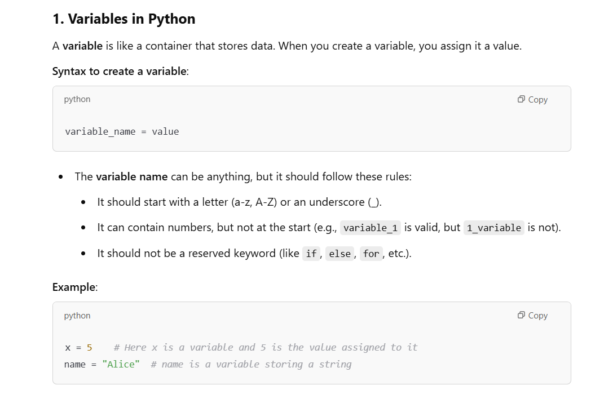
Variables in Python

Slide 8
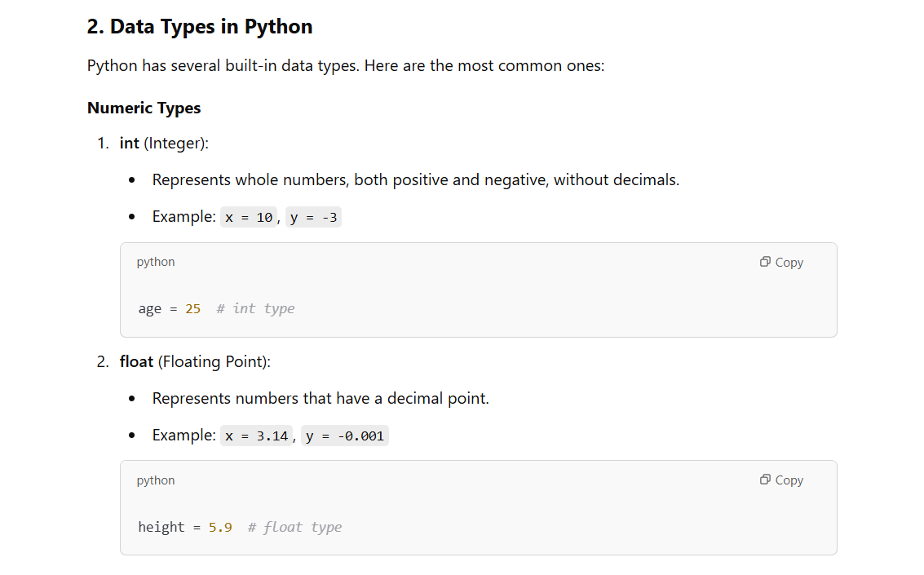

Slide 9
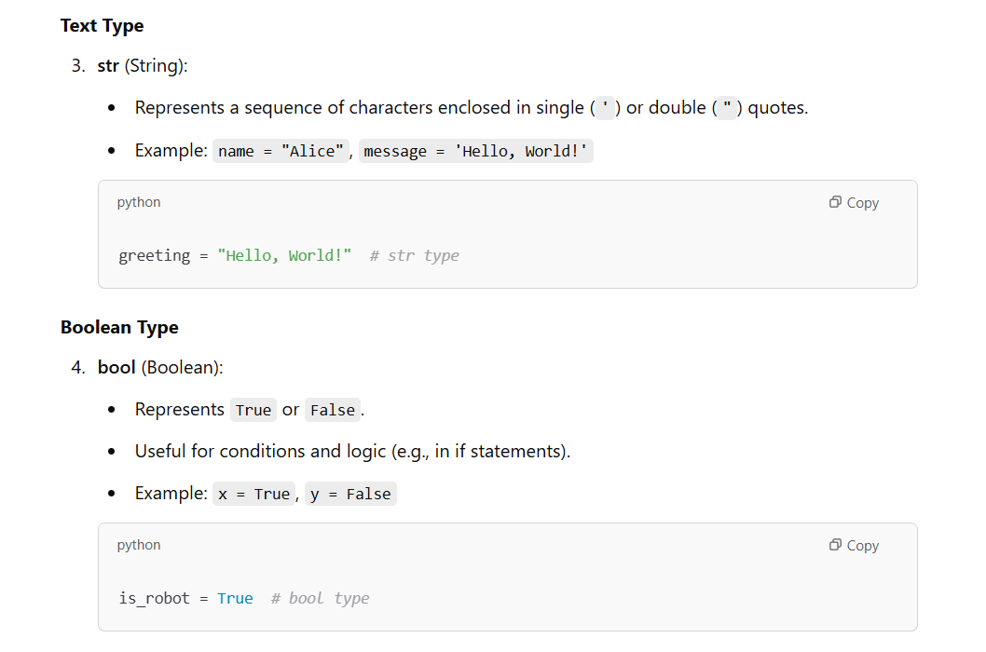

Slide 10
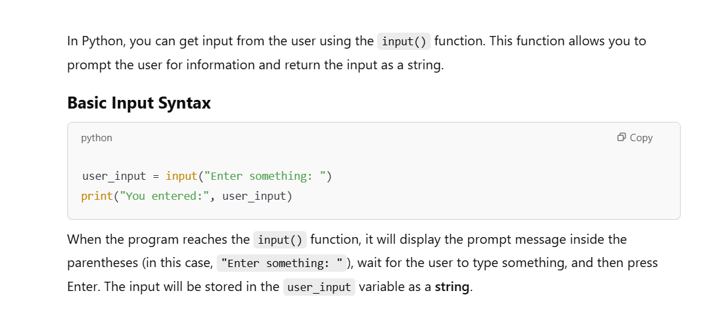
User Input in Python

Slide 11
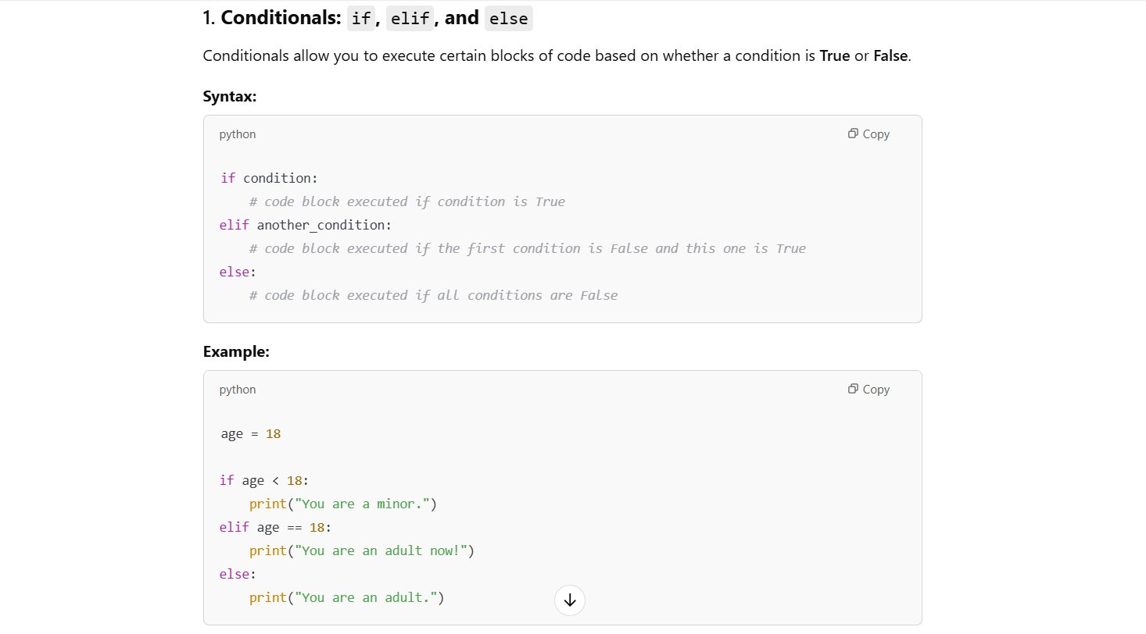

Slide 12
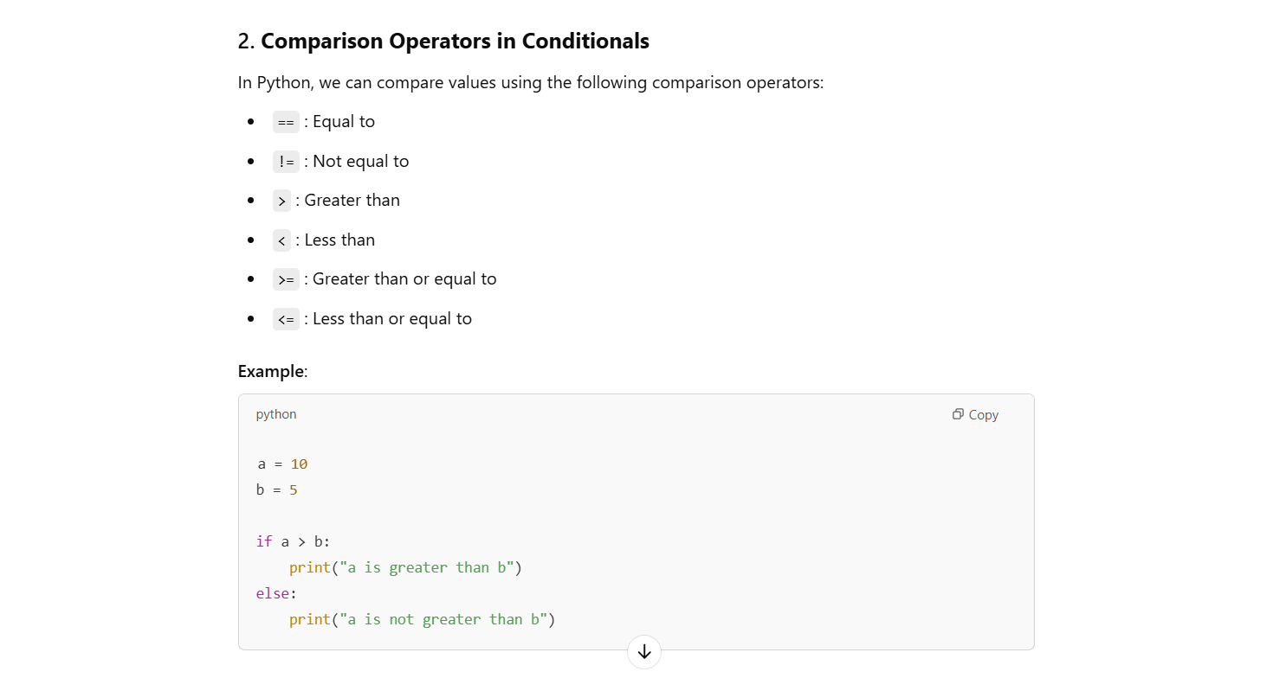

Slide 13
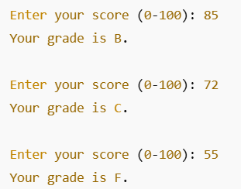
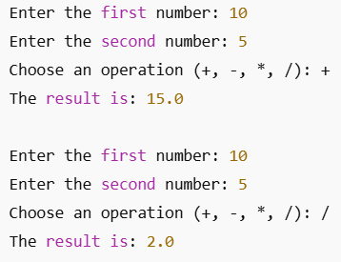
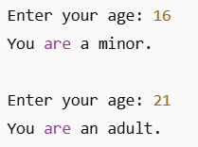
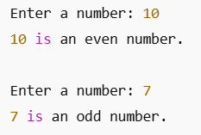
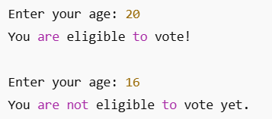

Slide 14
Age Checker

Slide 15
Even or odd number checker

Slide 16
Grade calculator

Slide 17
Simple Calculator

Slide 18
Voting Eligibility Checker

